Slide 1




(21CC505PC) SOFTWARE ENGINEERING
UPPAL CAMPUS
NARAYANGUDA
IBRAHIMPATNAM
LAB EXERCISE - 1
SRS DOCUMENT
TOPIC -1
INSTALLATION OF STARUML, GIT BASH AND
GITHUB ACCOUNT CREATION
BY
B MADHURIKA
Assistant Professor
CSE

Slide 2

SOFTWARE ENGINEERING LAB
(21CC505PC)
BY
MADHURIKA BUDARAJU
ASSISTANT PROFESSOR
CSE
KMIT

Slide 3
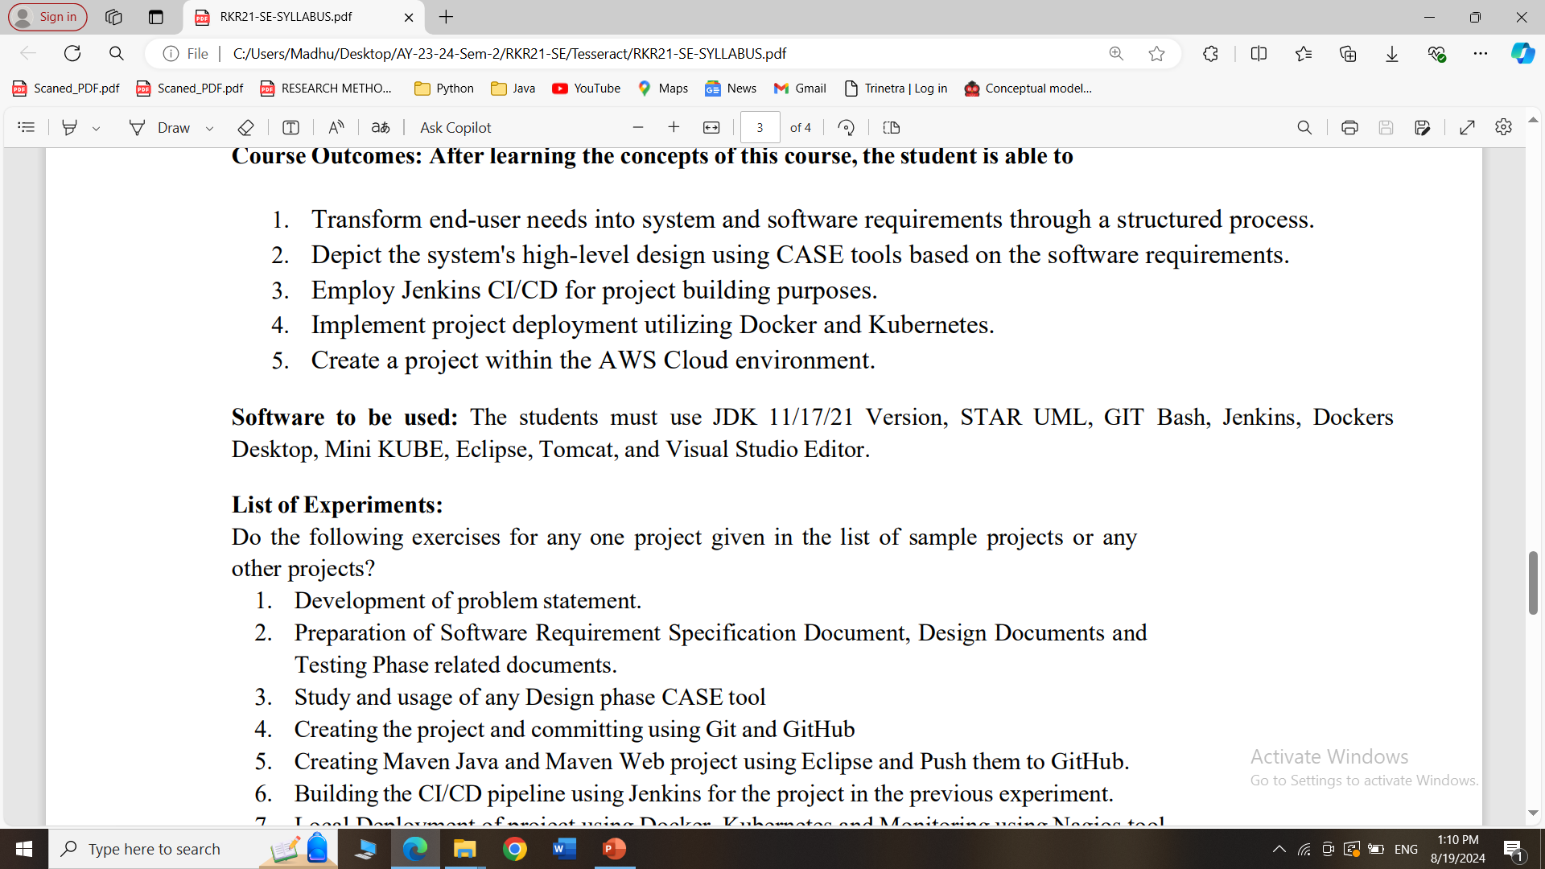
SYLLABUS

Slide 4
What is the use of STARUML?
StarUML is a software tool used to create diagrams that help in designing and understanding complex systems, especially in software development.
It allows you to visually map out how different parts of a system or application will work together, making it easier to plan, communicate, and build the system effectively.
Think of it as a drawing tool for software engineers to sketch out their ideas.

Slide 5
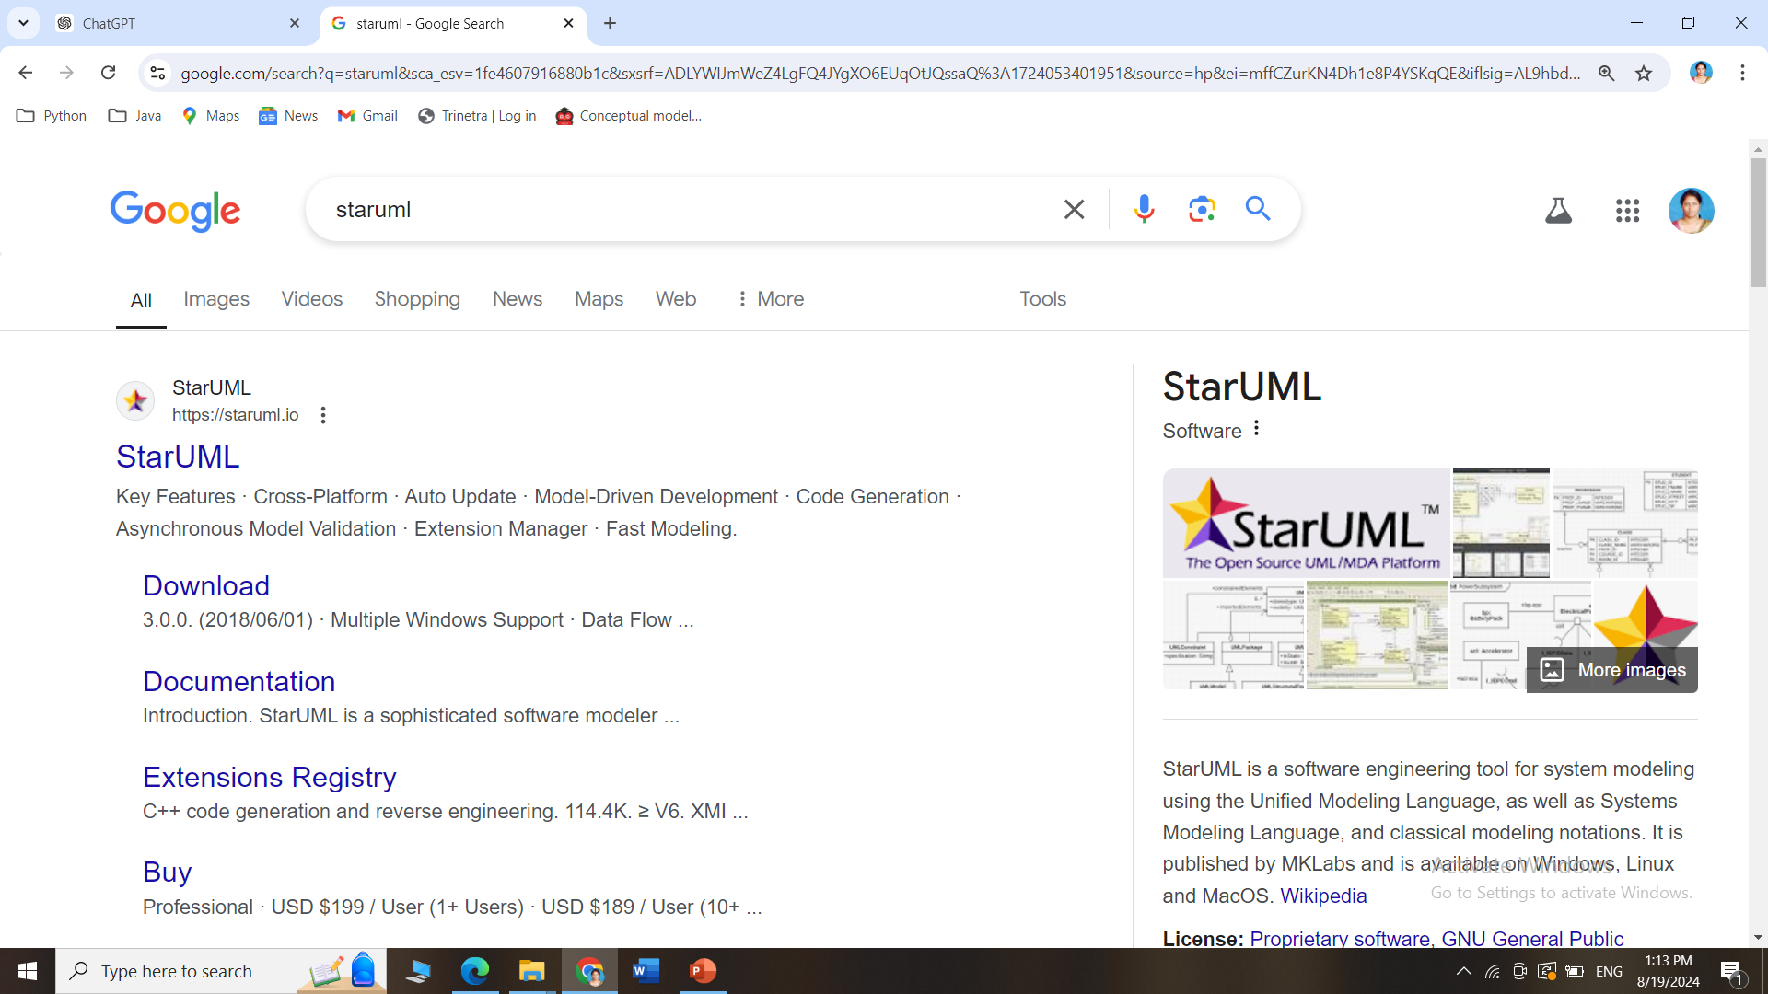
How to install STARUML
Search for StarUML in Google and Click on the official link

Slide 6
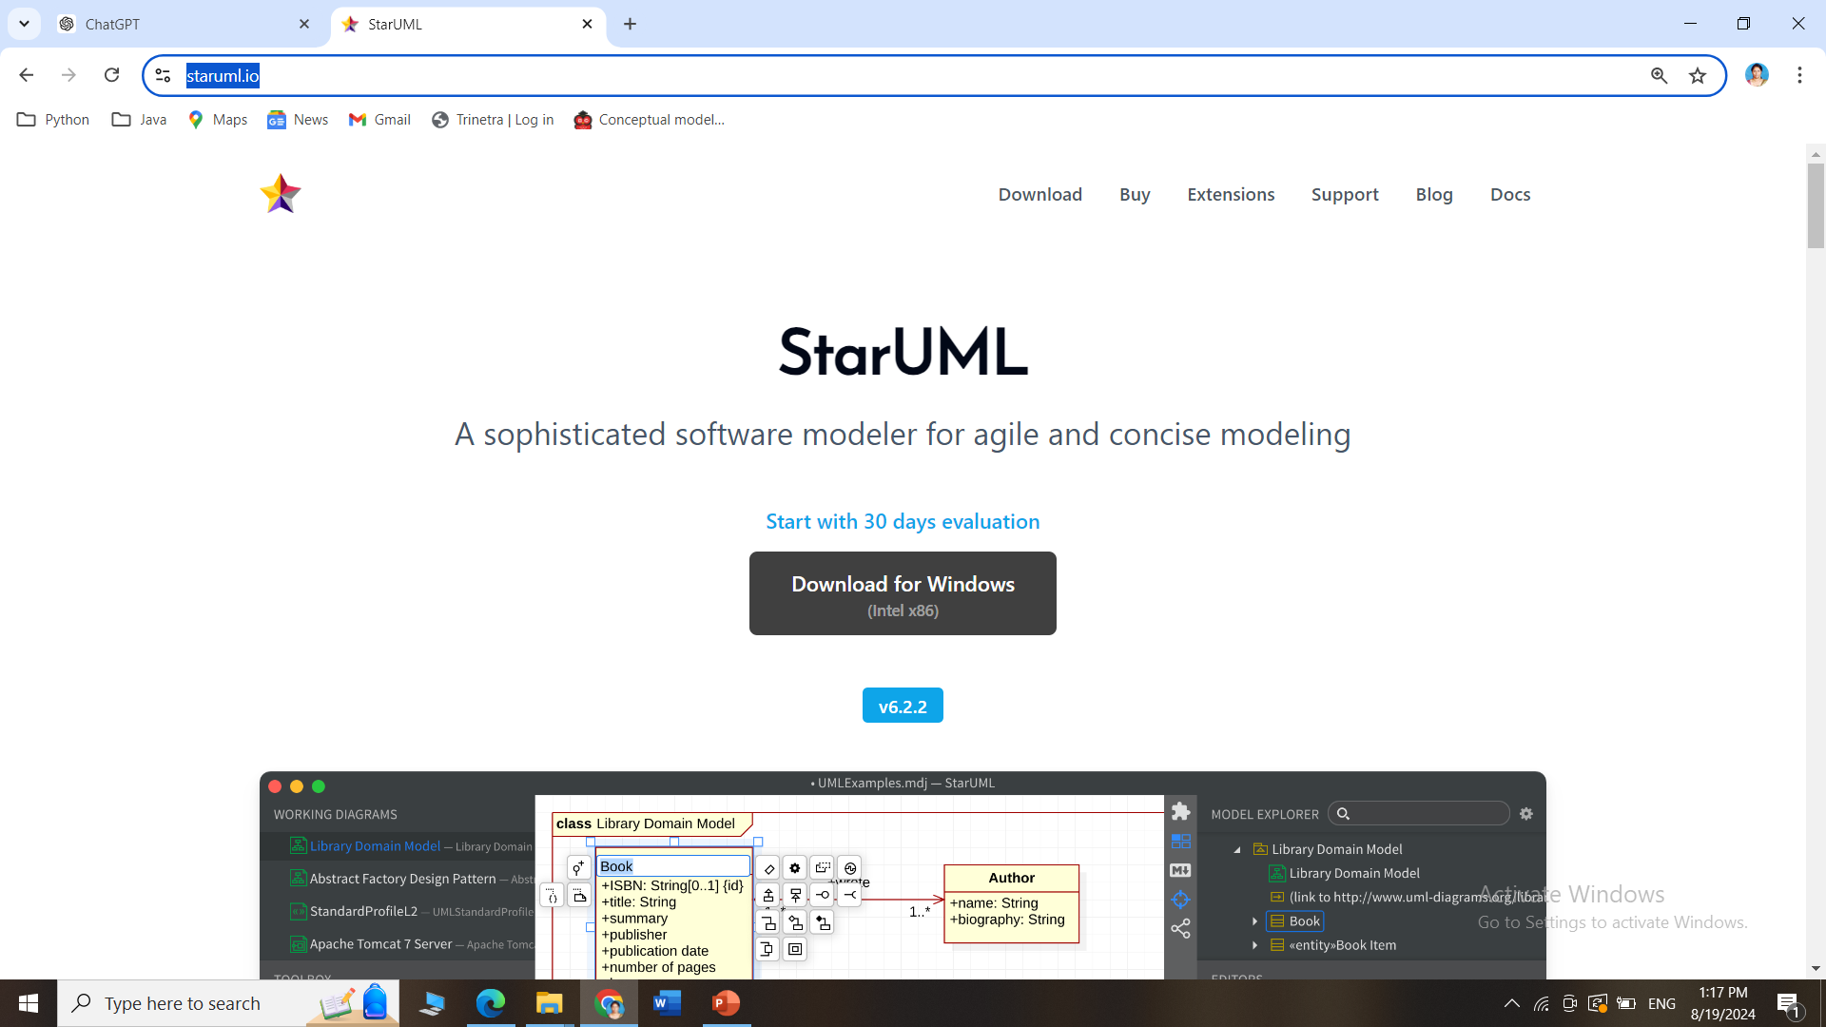
How to install STARUML
Go this site https://staruml.io/ and download StarUML for Windows/Mac

Slide 7
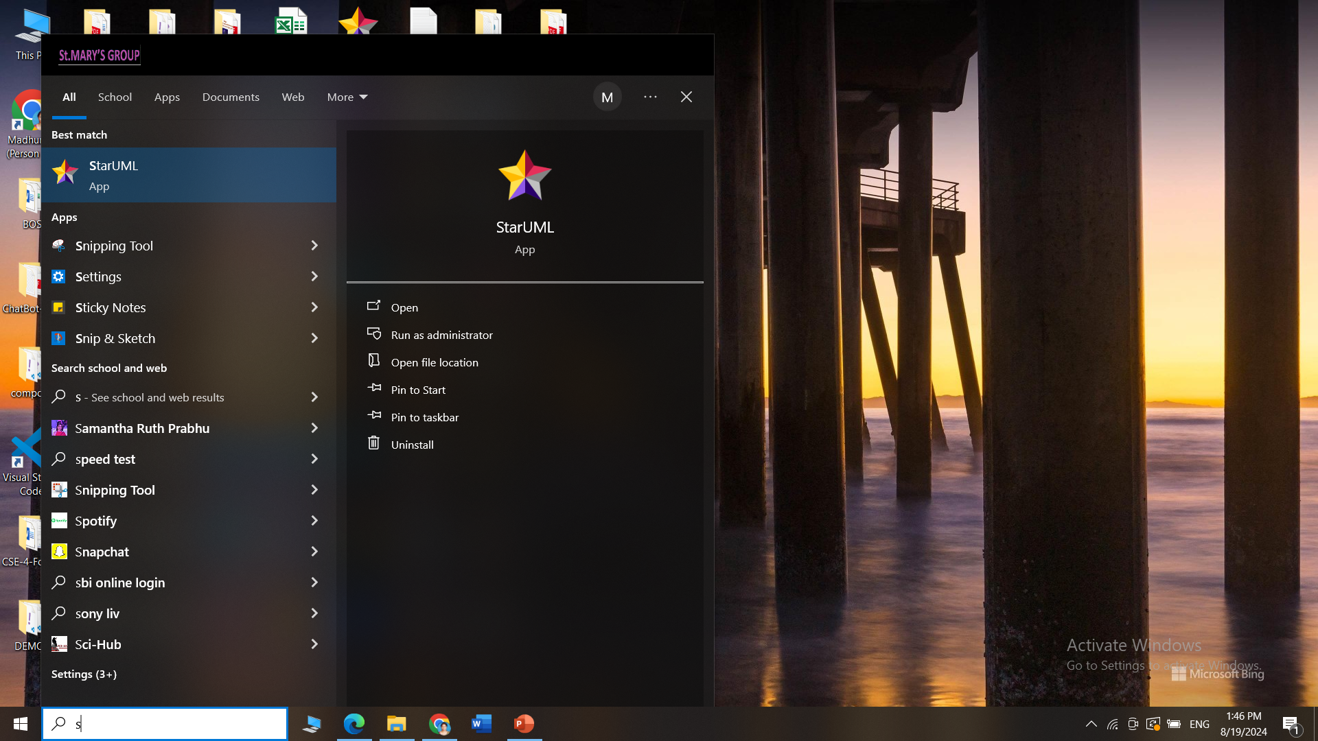
How to install STARUML
StarUML interface after installation

Slide 8
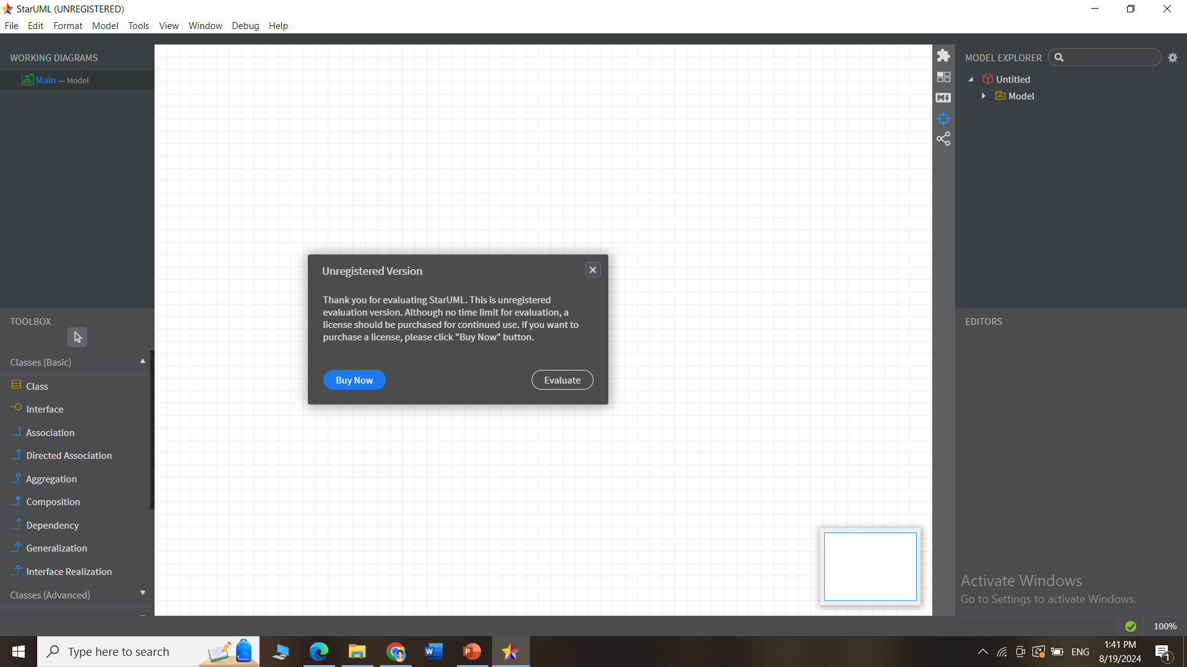
How to install STARUML
StarUML interface after installation

Slide 9
What is the use of GITBASH?
Git Bash is an application that lets you use Git commands on your computer.
Git: A tool for tracking changes in files, mainly used for managing code in software projects.
Bash: A command-line tool that allows you to type in commands to perform various tasks on your computer.
Purpose:
Git Bash combines Git and Bash, so you can easily manage your code and use commands to work with files and projects. It’s like a smart helper for keeping track of changes and collaborating with others on coding projects.

Slide 10
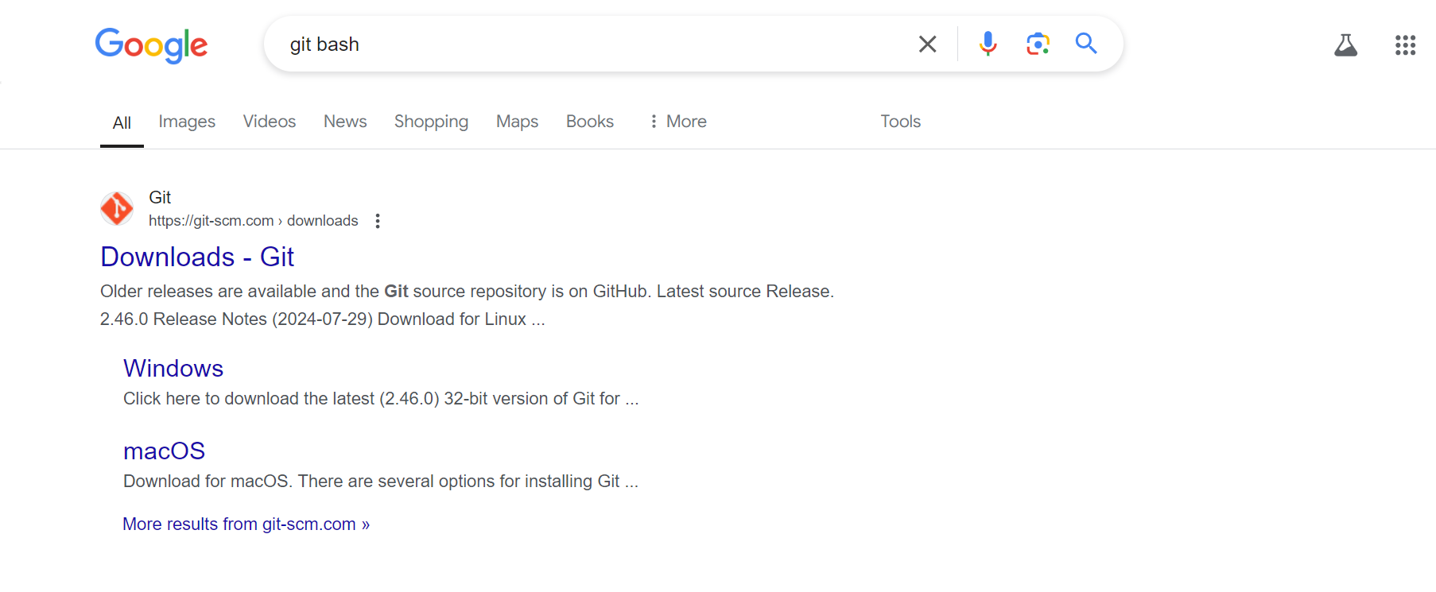
How to install Git
Search for git bash in Google and Click on the official link

Slide 11
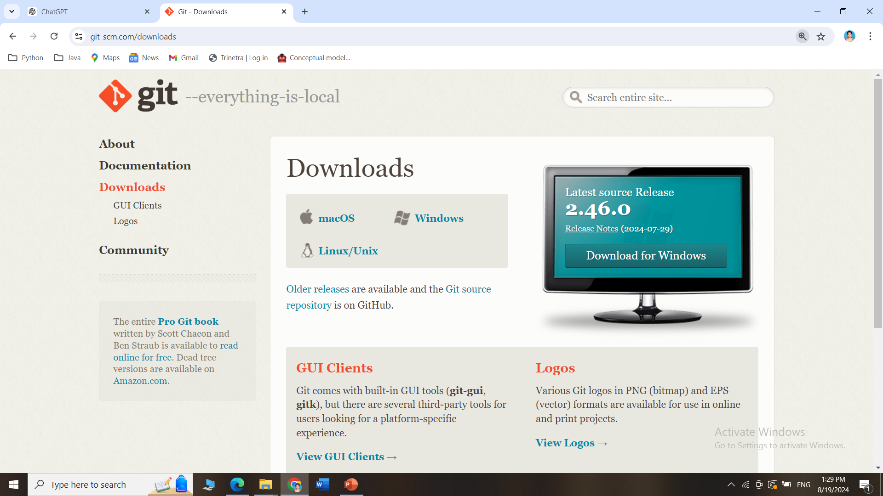
How to install GitBash
Go this site https://git-scm.com/downloads and download Git for Windows/Mac

Slide 12
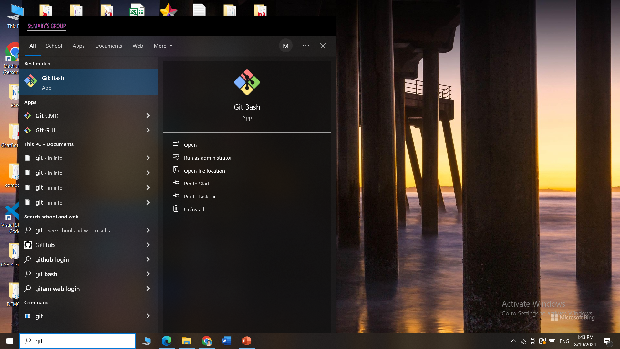
How to install Git
GitBash interface after installation

Slide 13
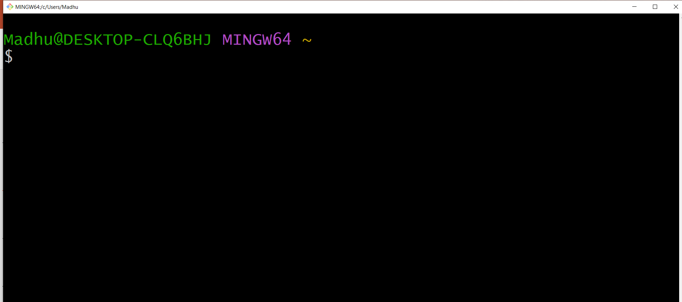
How to install Git
GitBash interface after installation

Slide 14
What is the use of GitHub?
GitHub is a website where people can store and share their computer code.
It's like a big, online folder where you can keep your work, make changes, and collaborate with others.
Think of it as a place where you and your team can work on a project together, track changes, and keep everything organized.

Slide 15
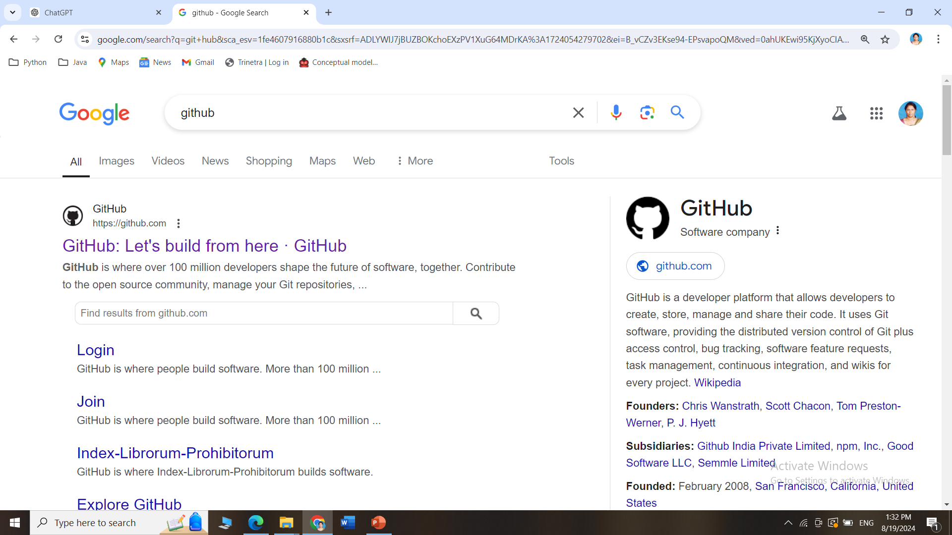
How to create an account in GitHub?
Search for github in Google and Click on the official link

Slide 16
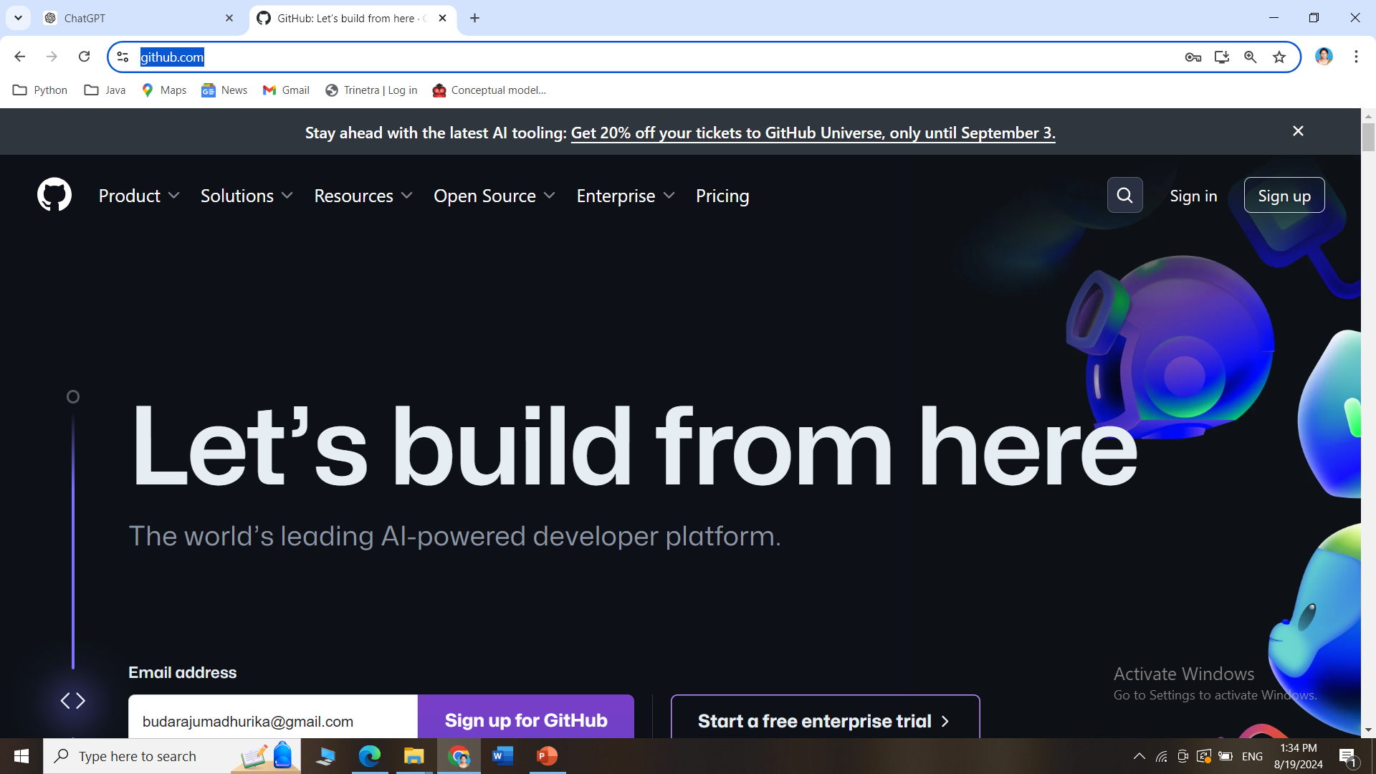
How to create an account in GitHub?
Go this site https://github.com/ and click on Sign Up

Slide 17
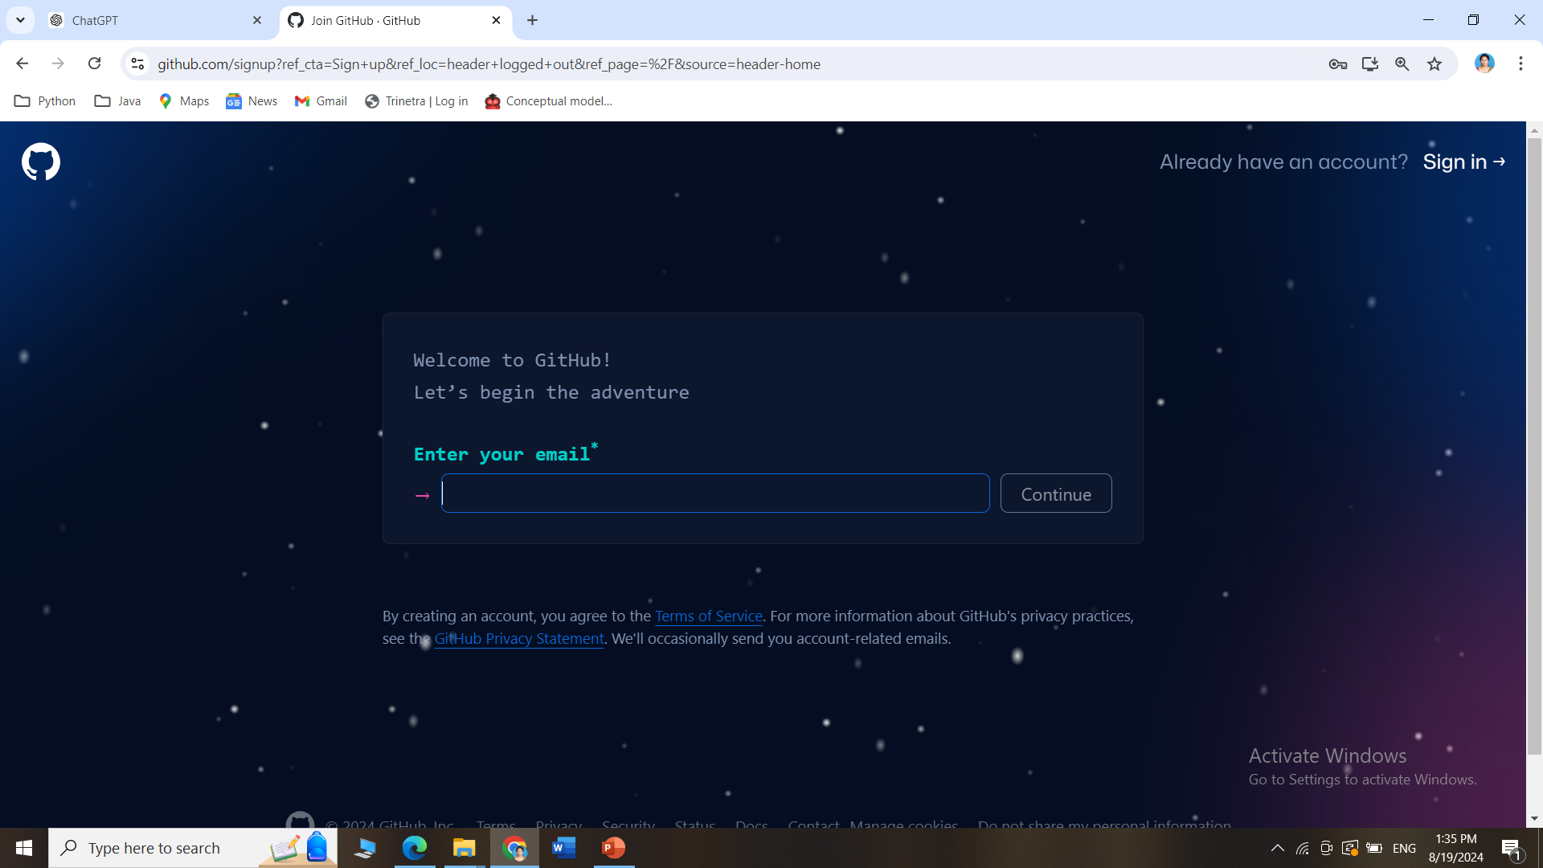
How to create an account in GitHub?
Follow the steps of Signup to create an account in GitHub

Slide 18
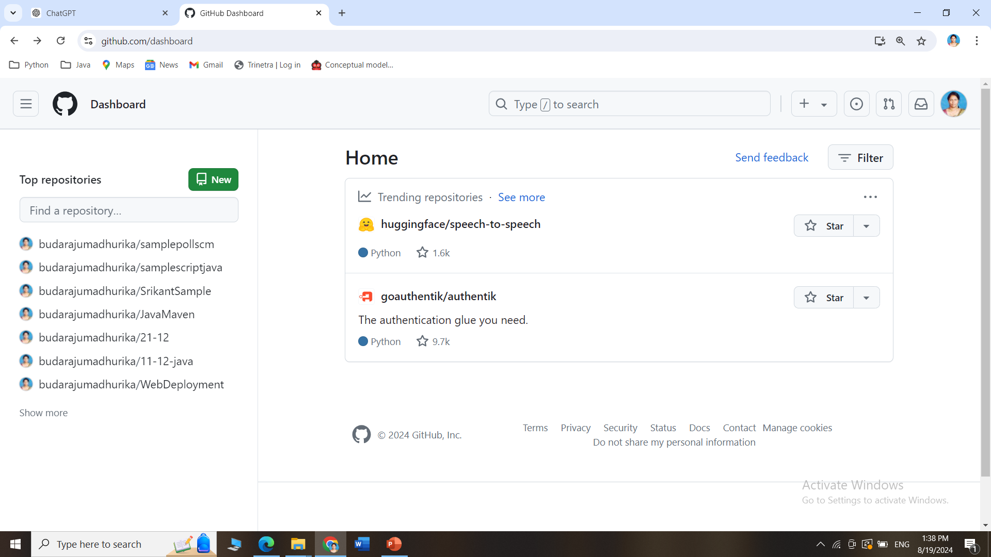
How to create an account in GitHub?
The GitHub dashboard after account creation

